Slide 1
Introduction to Apache Hadoop
Big Data Analytics with Python, AIMS-Rwanda 2022
Dunstan Matekenya, PhD

Slide 2
Outline
What is Hadoop?
Hadoop Ecosystem
HDFS
Mapreduce and YARN
Hive and Pig
How to get Hadoop
Hadoop Sandbox
Further readings

Slide 3
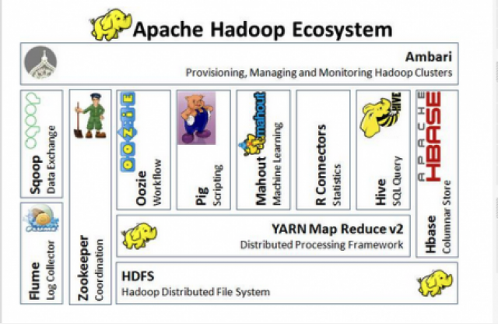
What is Apache Hadoop?
Apache Hadoop is an open source framework for distributed storage and processing of large sets of data on commodity hardware. Numerous Apache Software Foundation projects make up the services required by an enterprise to deploy, integrate and work with Hadoop.
Overview of Hadoop Components

Slide 4

What is Hadoop?
Set of open source programs and procedures used to process large amounts of data
Servers run applications on a cluster of computers
A Hadoop cluster handles parallel jobs or processes in fault tolerant fashion

Slide 5
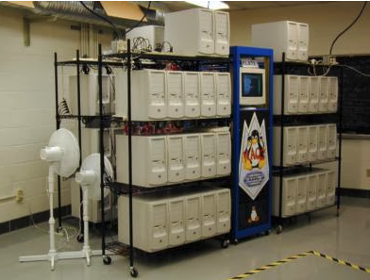
Cluster of Computers
Hadoop was designed to run on a cluster of networked computers such that the file system(HDFS) would look like a single unified system to the outside world.
The computers in the cluster dont have to be high end expensive, they can be commodity computers
A Hadoop cluster is a collection of computers working together in parallel to perform tasks

Slide 6
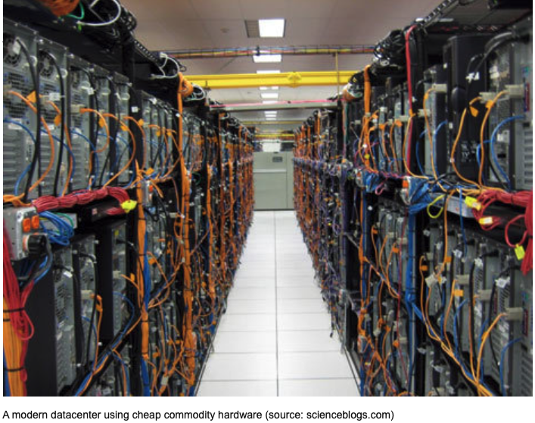

Slide 7

History of Hadoop
Apache Software Foundation Established
Nutch web search engine created
Google publishes work on Google File System(GFS) and Mapreduce
Nutch was divided into web crawler and distributed systems
Yahoo released Hadoop asn open source project
Hadoop 3.3.1
1999
2002
2003-2004
2006
2008
Present

Slide 8
The 5 Core Modules of Hadoop
Hadoop Common
(HDFS)
Hadoop Yarn
Hadoop Mapreduce
contains libraries and utilities needed by other Hadoop modules
Hadoop Distributed File System
Handles and stores large datasets across
Scales a single Hadoop cluster into as many as thousands of clustersa
Yet another resource negotiator (YARN)
A resource-management system
manages compute resources in clusters
schedules of users’ applications.
Hadoop’s processing unit
The first approach to interact with data in HDFS
Now many other approaches a exist
programming model for large scale data processing

Slide 9
Challenges of Hadoop
Processing transactions (random access)
When processes/work cannot be parallelized
When there are huge dependencies in the data
Low latency data access (since Hadoop relies on network connectivity across workers)
Processing many small files
Intensive calculations on small datasets
The Hadoop Ecosystem solved some of these problems

Slide 10
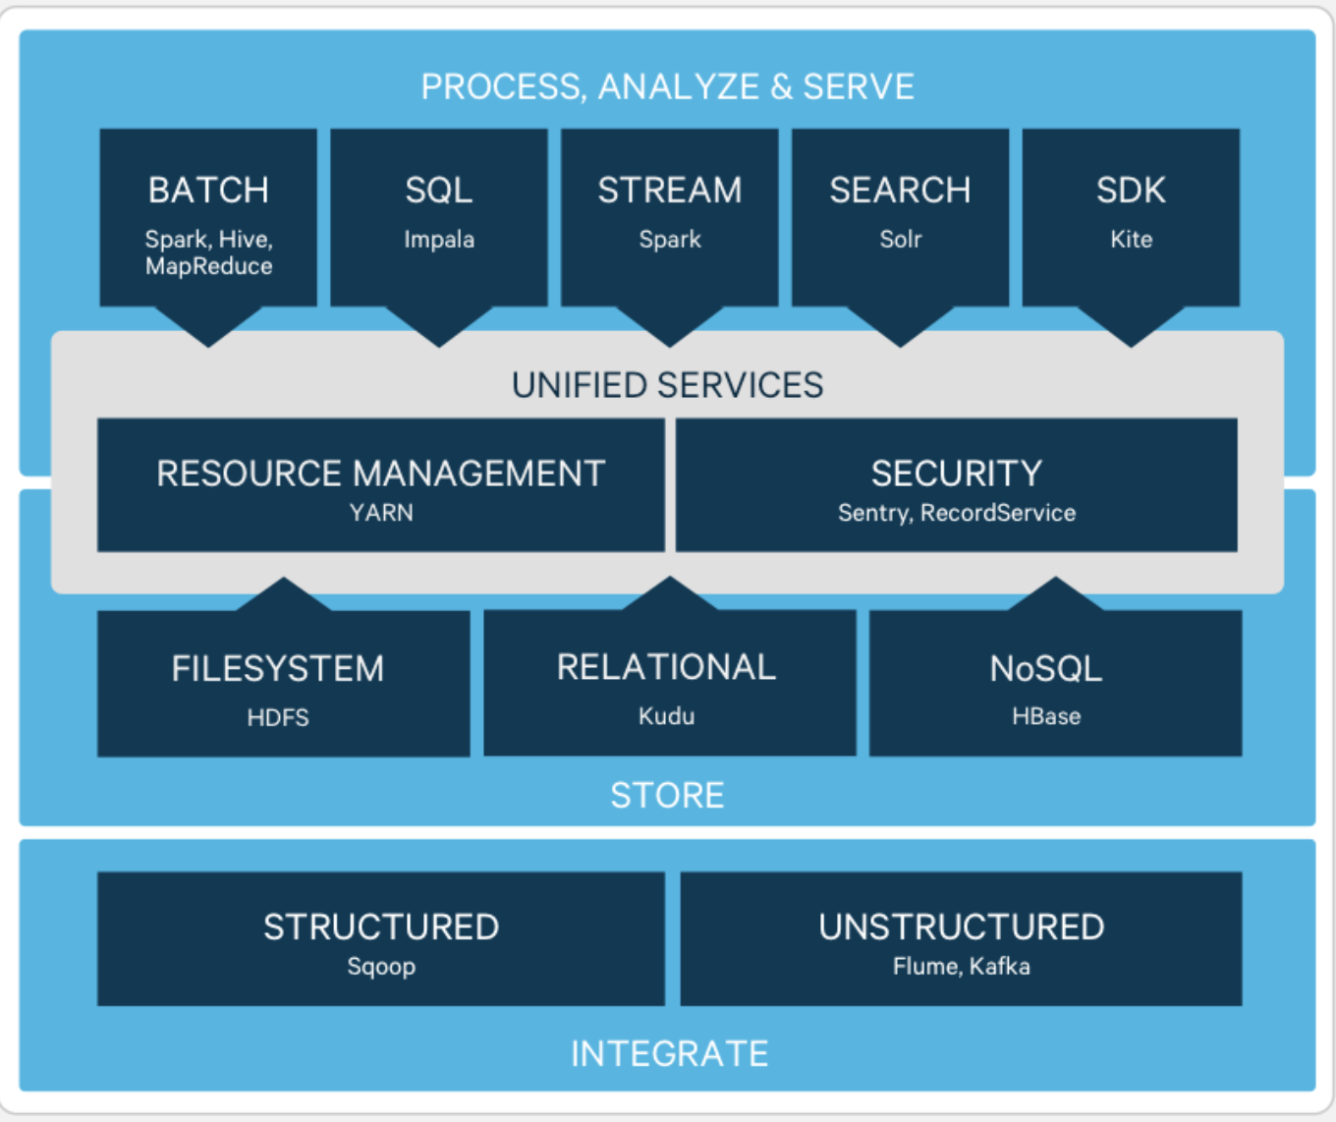
Overview of Hadoop Ecosystem

Slide 11
The Hadoop Ecosystem
The different components/open source projects that work together to make Hadoop work. These components can be grouped into 5 pillars.
Data Storage and Management
Data Access
Data Governance and Integration
Security
Operations
Interact with your data in a wide variety of ways – from batch to real-time
Address requirements of Authentication, Authorization, Accounting and Data Protection.
Provision, manage, monitor and operate Hadoop clusters at scale
.
Store and process vast quantities of data in a storage layer that scales linearly
Quickly and easily load data, and manage according to policy
Sqoop, Flume, Workflow management
Hive, Pig, MapReduce, Spark, HBase, Kafka
Ambari, Oozie and Zookeeper
HDFS, YARN
Knox, Ranger

Slide 12
Another Way to Look at the Ecosystem
INGEST DATA
Examples: Flume and Sqoop
STORE DATA
Examples: HDFS and HBase
PROCESS AND ANALYZE DATA
Examples: Hive, Pig and Spark
ACCESS DATA
Examples: Impala and Hue

Slide 13
Exercise [10 min]: Study Hadoop Components
Select from one of the following Hadoop Components (e.g., Ambari, Hive, Pig, HBase, Flume, Zeppelin). Please answer the following question:
What functionality does the component provide?
How does it fit into the Hadoop ecosystem/what purpose does it serve?
Any other information about the component

Slide 14
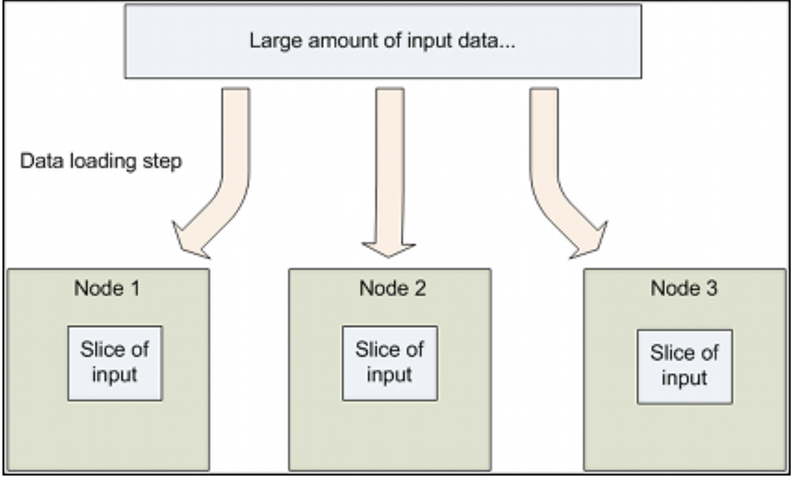
HDFS
A core component of Hadoop
HDFS is a distributed file system that is designed for storing large data files
HDFS is a Java-based file system that provides scalable and reliable data storage, and it was designed to span large clusters of commodity servers
This type of File system that manages storage of data across a network of machines is called a Distributed File System

Slide 15
How Does HDFS work?
An HDFS cluster is comprised of a NameNode, which manages the cluster metadata, and DataNodes that store the data
The file content is split into large blocks (typically 128 megabytes), and each block of the file is independently replicated at multiple DataNodes.
The blocks are stored on the local file system on the DataNodes.

Slide 16
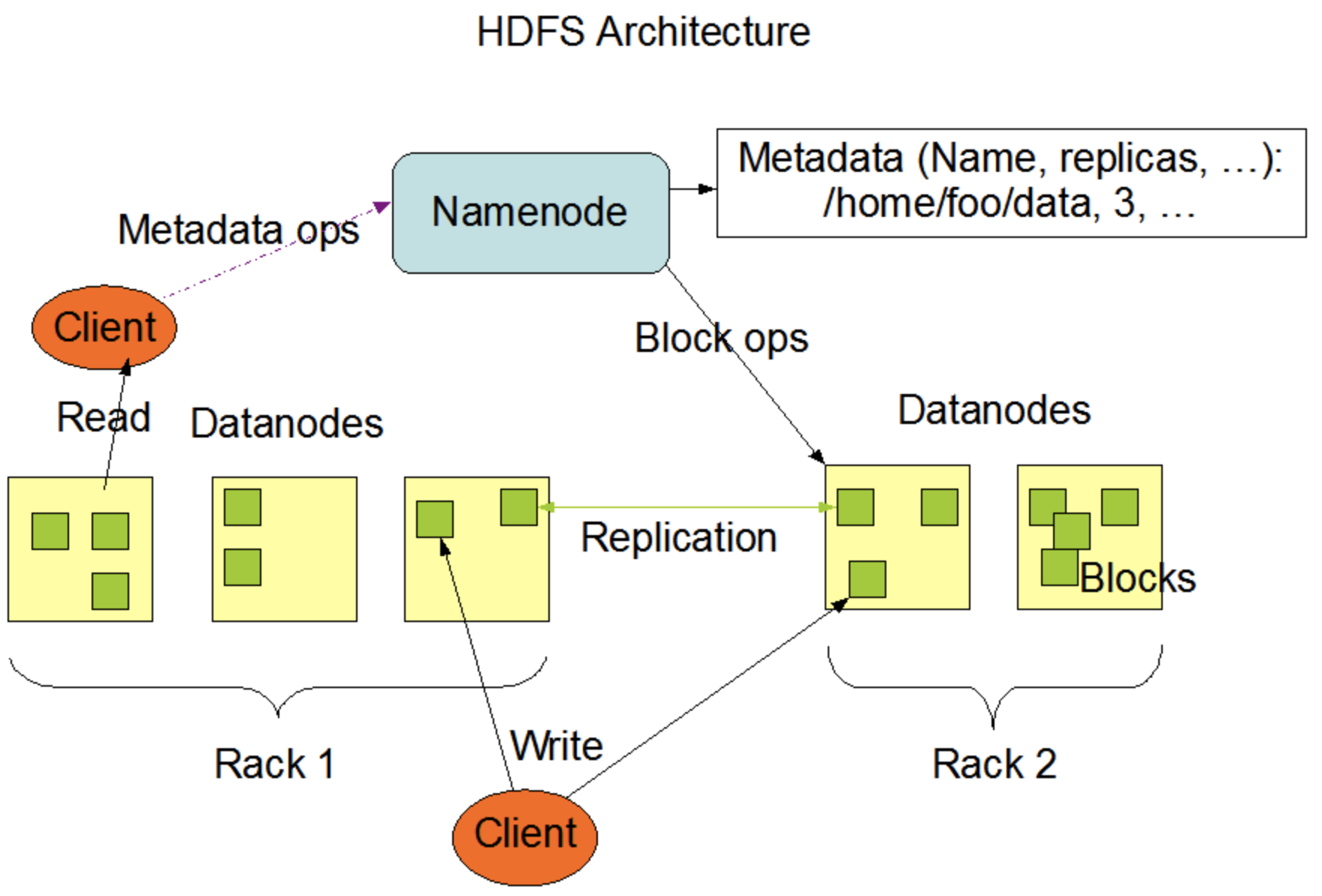
Architecture of HDFS-Namenodes

Slide 17
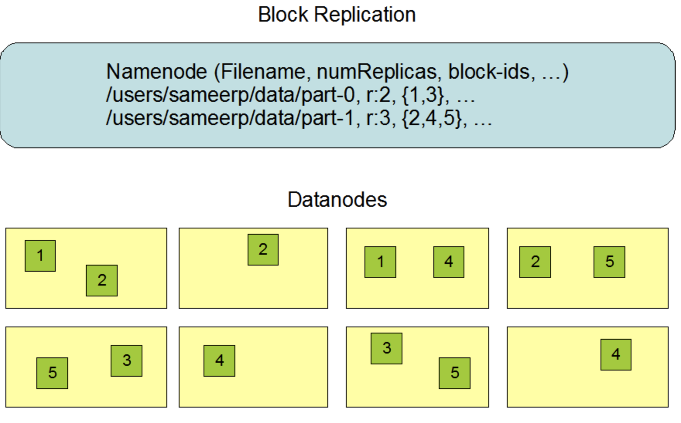
Architecture of HDFS-Data Repication

Slide 18
Further Resources on HDFS
Watch this short Youtube Video
Look at the documentation for HDFS

Slide 19
MapReduce and YARN
Challenges in cluster computing
The MapReduce Solution
How to store data persistently and keep it available if nodes fail
How to deal with node failures during a long running computation.
Network bottleneck which delays the time of processing data.
MapReduce offers a solution by bring computation close to data thereby minimizing data movement.
It is a simple programming model designed to process large volumes of data in parallel by dividing the job into a set of independent tasks.
In order to achieve maximum parallelism, YARN was born as a generic resource management and distributed application framework.

Slide 20
What is MapReduce
Programming model that the Hadoop data processing engine uses to distribute work around a cluster
Its a processing technique for distributed computing
A MapReduce job splits a large data set into independent chunks and organizes them into key, value pairs for parallel processing
Consists of a map task and a reduce task
This model can be coded in many programming languages: Java, Python, R

Slide 21
Map and Reduce
Given input file
Map task create key, value pairs
The output of each map task is partitioned into a group of key-value pairs for each reduce.
The Reduce function then collects the various results and combines them to answer the larger problem that the master node needs to solve
The current Apache Hadoop MapReduce System is composed of the JobTracker, which is the master, and the per-node slaves called TaskTrackers. The JobTracker is responsible for resource management (managing the worker nodes i.e. TaskTrackers), tracking resource consumption/availability and also job life-cycle management (scheduling individual tasks of the job, tracking progress, providing fault-tolerance for tasks etc).

Slide 22
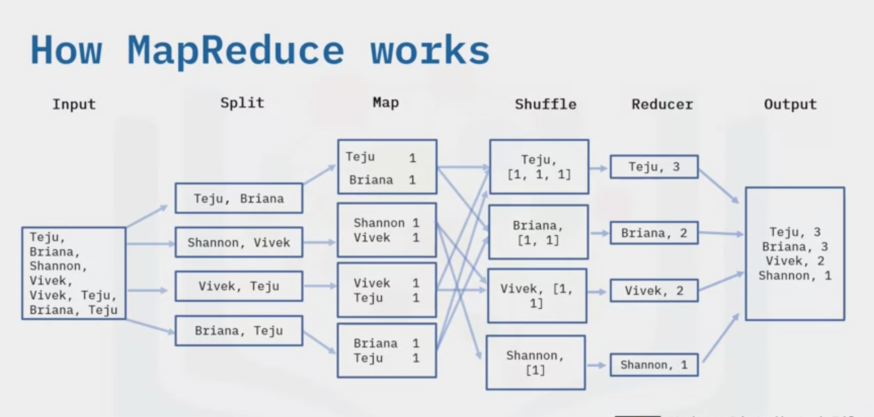
How Does MapReduce Works-The Word Counting Example

Slide 23
Some History and Challenges of MapReduce
In early days, the only way to interact with data in HDFS was through MapReduce programs
MapReduce programs aren’t that easy to write-you always need a mapper and reducer component
They needed to be written in Java
Next, Hive came along and made things easier
Fast forward to now, with Spark, you don’t need to explicitly write map and reduce

Slide 24
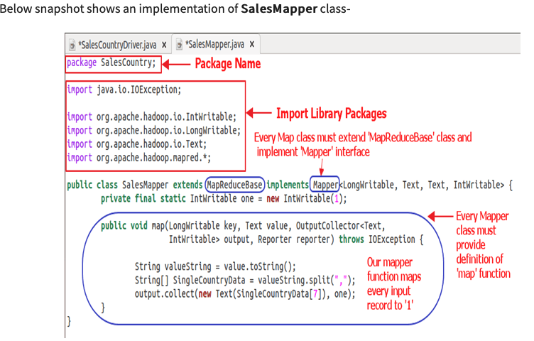
A Mapper Function in Java

Slide 25
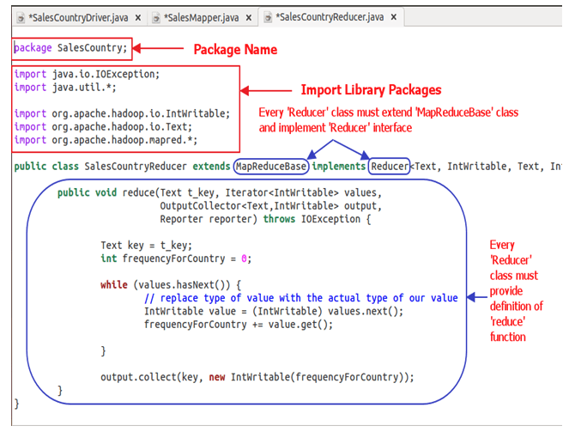
A Reducer Function in Java

Slide 26
Further Resources on MapReduce
Watch this short Youtube Video
For more detailed treatment of MapReduce, check this open source book: Mining Massive Datasets. Look at the Mapreduce section.
Full Mining Massive Datasets Book
This walkthrough tutorial on the MapReduce documentation page provides a good overview of how map and reduce functions work

Slide 27
YARN
Yet Another Resource Negotiator (YARN)
A core component of Hadoop
The resource manager and job scheduler for applications running on Hadoop
Enables orchestration for different programming models other than Hadoop (e.g., Spark)
Watch this 30 minute video to understand in-depth about YARN

Slide 28
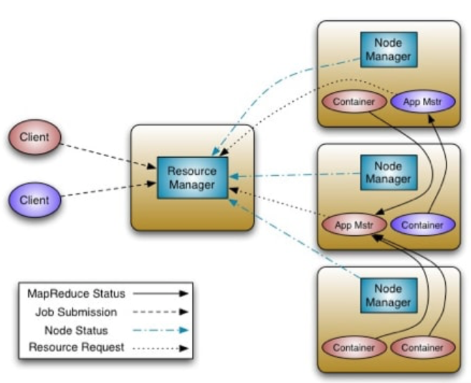
Architecture of YARN

Slide 29

Hive and Pig
Hive is an SQL like query language that enables those analysts familiar with SQL to run queries on large volumes of data
Hive users have a choice of 3 runtimes when executing SQL queries.
Users can choose between Apache Hadoop MapReduce, Apache Tez or Apache Spark frameworks as their execution backend.
Pig consists of a high-level language (Pig Latin) for expressing data analysis programs paired with the MapReduce framework for processing these programs.

Slide 30
Exercise [5-10 min]: Hive vs. Pig
Find documentation on Hive and Pig and explain the key differences between the two?
When would you use Hive instead of Pig

Slide 31
Ambari
The Apache Ambari project is aimed at making Hadoop management simpler by developing software for provisioning, managing, and monitoring Apache Hadoop clusters. Ambari provides an intuitive, easy-to-use Hadoop management web UI backed by its RESTful APIs.
Ambari enables system admin to do the following:
Provision a Hadoop Cluster
Manage cluster
Monitor cluster Health

Slide 32
How Do you Get Hadoop?

Slide 33
How to get Hadoop?
Answer several questions first: do you want it on-premise or on the cloud? Do you want to use it on a single computer (single node) or you would like to create cluster?
Hadoop is open source, so you can build Hadoop cluster on your own
The above option is difficult, often easier to use distributors and vendors

Slide 34
Top Hadoop Commercial Vendors
Amazon Elastic Mapreduce
Cloudera CDH Hadoop Distribution
Hortonworks Data Platform(HDP) (since then deprecated)
MapR Hadoop distribution
Databricks (built on top Apache Spark)
Microsoft Azure's HDInsight -Cloud based Hadoop Distrbution
Most Cloud providers have some form of hadoop based or other distributed data processing frameworks

Slide 35
Hortonworks Sandbox
The easiest way to explore Hadoop and all its components is through installing a Hortonworks HDP (a distribution of Hadoop)
We have installed this Sandbox on the Lab desktop computers
We will explore some components of Hadoop on this single node cluster through some tutorials

Slide 36
Summary
The Apache Hadoop projects provide a series of tools designed to solve big data problems.
The Hadoop cluster implements a parallel computing cluster using inexpensive commodity hardware.
The cluster is partitioned across many servers to provide a near linear scalability.
The philosophy of the cluster design is to bring the computing to the data.
The Hadoop cluster design is resilient and fault tolerant
The core components of Hadoop are Hadoop commons, HDFS, YARN and MapReduce
The Hadoop ecosystem has several open source projects which work together to bring different functionality. For instance, Hive, Pig, Flume, Spark, Ambari

Slide 37
Further Resources Summary
Watch this short Youtube Video
For more detailed treatment of MapReduce, check this open source book: Mining Massive Datasets. Look at the Mapreduce section.
Full Mining Massive Datasets Book
This walkthrough tutorial on the MapReduce documentation page provides a good overview of how map and reduce functions work
Watch this 30 minute video to understand in-depth about YARN
Watch this short Youtube Video
Look at the documentation for HDFS
Learn about Kubernetes, its an essential technology in the Big Data space
Make Sure you watch the videos linked above!!!

